Slide 1
SEF
Introduction to
Requirements

Slide 2
Reading
Intro to Requirements
Continue w/assigned reading.
If you haven't read Chapter 3 of Code Complete, do it this week.

Slide 3
Requirements
A Background

Slide 4
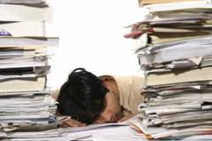
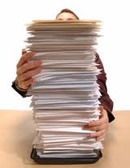

Requirements …
Intro to Requirements
What exactly are requirements ?
What do they tell us ?
Why do we need them ?

Slide 5


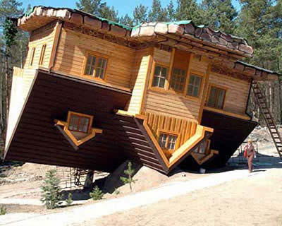
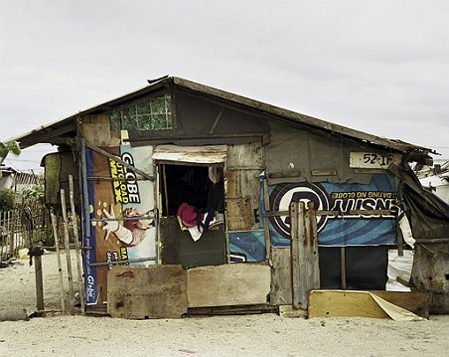
Let’s figure this out …
Intro to Requirements
These are all very good questions, and we’ve come up with some good ideas and reasons … but how specific do requirements need to be ?
  If I went to a builder and gave them the requirement of “build me a house” – what would I end up with ?
    Or what about this ?
  The point is – my requirement of “build me a house” is not specific enough … I need to tell them
    What the main purpose of the house is
    How many people will be living in the house
    What kind of features the house needs
    What external conditions will the house need to stand-up to
    How many rooms and what types of rooms the house needs
    etc.
    Maybe this ?
    Or this ?
    Or even this ?
  And how do I tell them this information ?!?!
  !! REQUIREMENTS !!

Slide 6

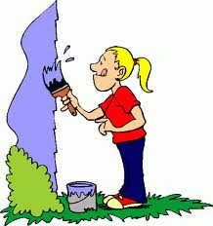
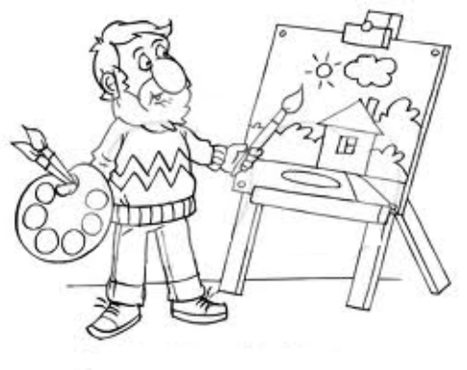
Let’s figure this out (cont’d)
Intro to Requirements
Let’s look at another example to make the point … what would you do if I asked you to “paint my house” ?
  Would you …
  Or maybe …
  Or even …

Slide 7

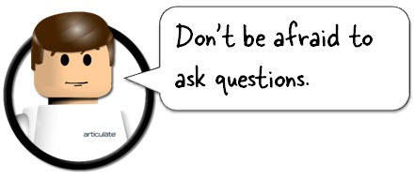
Let’s figure this out (cont’d)
Intro to Requirements
Again … my requirements (“Paint my house”) weren’t specific enough
What do you think you need to do if the requirements given
  Aren’t specific enough to accurately do what you need to do ?
  Raise questions in your mind about what the person requesting meant?
  Who do you ask ?
    You ask the person who gave you the requirements !

Slide 8
Let’s figure this out (cont’d)
Intro to Requirements
Okay – so this is what we know so far about requirements
  What are they ?
    A series of statements used to describe a system, product or object (the thing) that needs to be created or built
    Note that these statements need to be quite specific and unambiguously describe the thing
      Ensuring this can tend to make the process of documenting requirements quite involved
  What do they tell us ?
    They can tell us, what the thing needs to be, needs to do, how it needs to behave, what its purpose it, etc.
  Why do we need them ?
    In creating or building a thing, requirements are needs to avoid mistakes, miscommunications or assumptions
    Requirements are a way of making sure that everyone involved in creating the thing is working towards the same goal and is creating the same thing

Slide 9
Why we need Requirements …
Intro to Requirements
Sometimes projects are undertaken that do have requirements and still they fail … why ?
  Because the requirements
    Weren’t good and clear
    Weren’t specific enough
    The people involved made assumptions
    Any number of other reasons …
Let’s watch a couple of short videos about how and why projects fails:
  Let’s look at some statistics of what is happening at this second
  Project Development (according to Borland)
  Requirements Gathering and Review Meeting

Slide 10
Starting at the Beginning …

Slide 11
The Traditional Stages of System Development
Intro to Requirements
The traditional process for the design of programs (or systems) is an iterative one
  Where you go through various stages
  And backtrack whenever necessary
Let’s identify the Stages …
  Stage 1: Requirements
  Stage 2: Architecture / Design
  Stage 3: Construction (Coding)
  Stage 4: System Test
  Stage 5: Post-release (Maintenance)
    These stages help to form the basis of the SDLC (System Development Life Cycle) that you will learn more about next semester

Slide 12
Other Approaches
Intro to Requirements
As you will learn throughout your Software Engineering courses here in SET, there are many other approaches that can be taken in System Development as well.
  In all approaches however, generating the correct requirements is vital

Slide 13
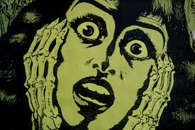
Requirements
Intro to Requirements
Getting correct and accurate requirements is the most important part of the development process
  The earlier -- the better
    Less to potentially undo
    Less time that is wasted
The main idea and reason for gathering the requirements is to avoid surprises!
  Surprises are expensive in terms of time,
  money, and frustration

Slide 14

Requirements (cont’d)
Intro to Requirements
Requirements need to emphasize what needs to be done rather than how to do it
  In terms of System Development, when you begin to tell people how to do something, you are actually doing design work (Stage 2)
The main goal of requirements gathering and preparation is Risk Reduction

Slide 15
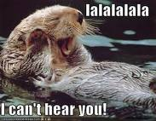
Reasons Why Requirements Aren't Researched
Intro to Requirements
As humans, we often know what we should do and need to do, but we don’t do it anyway …
The same is true for gathering requirements
  Here are some reasons why gathering requirements may be overlooked :
      The people responsible for doing it don't have the expertise
      The people responsible for doing it want to jump right into coding
      The bosses of the people responsible for doing it have no patience for requirements
      The system / project is small enough and everyone knows what to do

Slide 16
A Reason for doing Requirements
Intro to Requirements
There are many, many reasons why taking the time to gather requirements is a good thing …
But pages 27 to 31 in Code Complete actually give you (and your manager) a great business justification for doing so
  Pay close attention to Table 3-1

Slide 17

Business Reason …
Intro to Requirements
Average cost (in $K) of fixing defects based on when they're introduced and detected …
Detected
 | Req. | Arch. | Coding | Sys. Test | Maint.
Req. | 1 | 3 | 5 – 10 | 10 | 10 – 100
Arch. |  | 1 | 10 | 15 | 25 – 100
Coding |  |  | 1 | 10 | 10 -25

Slide 18
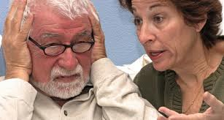
Why have Official Requirements?
Intro to Requirements
Okay, okay … I get it ! We need requirements !
But tell me – do they have to be official ?
Meaning – is it necessary to document them in some official type of document ?
  The answer is Yes ! And here are some reasons why …
      Have the user drive the functionality
      Avoid arguments and interpretations
      Easier to spot and eliminate errors and inconsistencies earlier than later
      If all interested parties read, understand and sign-off on the requirements – then it forms a basis of an agreement … or contract …

Slide 19
Well - how do we gather requirements ?
Intro to Requirements
There are many different strategies and techniques for gathering requirements effectively
  We will be taking a course in the Winter which has a whole unit dedicated to gathering requirements
For now, just know that to gather requirements, you will :
  Need to determine what needs to be done at a more general, uncomplicated level
  Need to interact with a customer or client (or multiple).
  Need to match customer's needs with what the product ultimately provides.

Slide 20
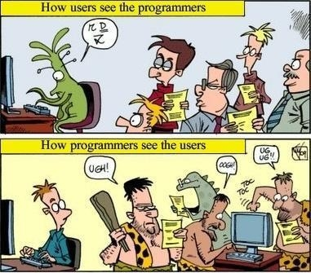
Hang on here … Customer?
Intro to Requirements
The use of the word customer refers not only to the end user but also to other people / organizations with vested interests in what you're producing.
  e.g. marketing department, board of directors, etc.
  Sometimes these people are referred to as stakeholders
You need to decide (and prioritize) who are your customers and what their roles are …
Do customers really know what it is that they want ?!?
  This sounds like a silly question, but sometimes this is the way that customers and developers see each other …

Slide 21
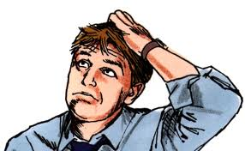
Major Issue with Customers
Intro to Requirements
What a customer says they want might not be what they really need
  Its not their fault – without
  knowing it, they might be
  suggesting a solution rather than a statement of their problem.
    For example, in the early days of the internet, a customer may have said that “they need the ability to turn off graphics loading”
    But what they really need is an increase in speed of page loading.
It is vitally important that someone have a dialogue with the customer to avoid producing the wrong product

Slide 22


Getting Info From Customers
Intro to Requirements
Okay – so now we need to talk to the customer(s) / stakeholder(s) to make sure we really understand what they are asking for
We can do this by :
  Getting feedback from previous users
  Having Customer Focus Groups
  Doing surveys
  Taking field trips to the customer site

Slide 23
10 Tips
Intro to Requirements
Here are 10 tips for getting useful info from users
  As suggested in IEEE Software (July 1988)
  Include real end users
  Don't ask users to do your job
  Overcome resistance to change
  Use data to settle differences of opinion
  Leave room for users to change their minds
  Keep an open mind
  Live in their camp for a while
  Get some communications help
  Don't rely on memory or general impressions
  Don't rush to write things off as too difficult

Slide 24
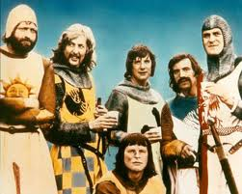
Stable Requirements
Intro to Requirements
Okay – so now we see the importance of gathering requirements … we know that we need to speak with the customer to gather them
  So once we’ve gathered them and we know what the customer wants, then we can begin building the system because we have stable (unchanging) requirements
Nope, sorry it won’t happen – thinking that
you will have stable requirements is the
classic Search for the Holy Grail
  Studies have shown that 25% of the average project's requirements will change.
  Although this video is a bit over-the-top, it does prove the point The Stop-Sign Project

Slide 25

But ...
Intro to Requirements
Your requirements definitely won't be stable unless you have them documented
  So let’s all learn to be Dr. Documentation !

Slide 26
Dealing with Changes
Intro to Requirements
We accept the fact that requirements will change but how do we deal with that ?
You have to :
  Assess the quality of your requirements (pages 42 and 43 of Code Complete)
      Make sure to use this checklist before handing in Assignment 1
  Make sure everyone knows the cost of requirements changes
  Set up a change-control procedure
  Use development approaches that accommodate changes
  Dump the project
  Keep your eye on the business case for the project

Slide 27
Documenting Requirements
Intro to Requirements
How is that we assemble and document the requirements that we’ve gathered ?
  Many projects use a formal Software Requirements Specification (SRS)
  This is a document containing a set of precisely stated properties or constraints which a software system must satisfy
    The SRS for a missile defense system (DOD 1977) was 2500 pages long and had 8000 distinct requirements.
All well written SRS’s share certain characteristics … let’s look at what these characteristics are …

Slide 28

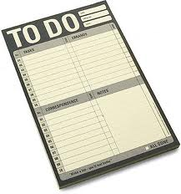

Characteristics of a Good SRS
Intro to Requirements
A well written SRS must be :
  Understandable by End Users
    Need to watch the technical language issues
  Non-Prescriptive
    say what to do -- not how to do it
    The exception to this is if there is a constraint on the implementation
  Correct
    must represent what the user needs
    user makes the final decision

Slide 29

Characteristics of a Good SRS (cont’d)
Intro to Requirements
Complete
  A complete SRS must possess the following qualities:
    inclusion of all significant requirements
    definition of the responses of the software to all realizable classes of input
    conformity to any standard that applies to it
    full labeling and referencing of all tables and diagrams and the definition of all terms

Slide 30


Intro to Requirements
Characteristics of a Good SRS (cont’d)
Concise
  To the point
  Don't hide information
Clear
  Related to and understandable by the user
  Shouldn’t require clarification

Slide 31
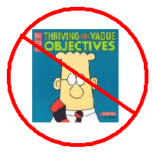

Intro to Requirements
Characteristics of a Good SRS (cont’d)
Precise
  Must not be vague (need a single clear interpretation)
Unambiguous
  Every requirement has exactly one interpretation.
  Each characteristic of the final product is described using a single unique term.
  A glossary should be used when a term used in a particular context could have multiple meanings.

Slide 32
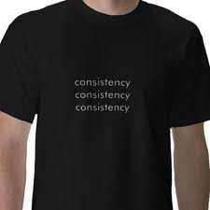
Intro to Requirements
Characteristics of a Good SRS (cont’d)
Consistent
  No set of individual requirements described in the SRS can be in conflict.
  Types of likely conflicts:
    Two or more requirements describe the same real world object in different terms.
    The specified characteristics of real world objects might conflict.
    There may be a logical or temporal conflict between two specified actions.

Slide 33
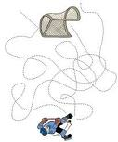
Intro to Requirements
Characteristics of a Good SRS (cont’d)
Traceable
  The origin of each requirement must be clear.
  The SRS should facilitate the referencing of each requirement in future development or enhancement documentation.
  Types:
    Backward Traceability : Each requirement must explicitly reference its source in previous documents.
    Forward Traceability : Each requirement must have an unique name or reference number.

Slide 34

Intro to Requirements
Characteristics of a Good SRS (cont’d)
Modifiable
  The structure and style of the SRS are such that any necessary changes to the requirements can be made easily, completely and consistently.
  When it comes to documenting Requirements this means we need:
    a coherent and easy-to-use organization
      including a table of contents, index and cross-referencing
    that a requirement / definition / description be stated only once in the document
      not be redundant - this can lead to errors
      where you may update one description
      and forget the 2nd or 3rd …

Slide 35

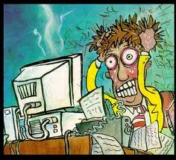
Intro to Requirements
Characteristics of a Good SRS (cont’d)
Verifiable
  Every requirement must be verifiable.
  There must exist some finite cost-effective process with which a person or machine can check that the software meets the requirement.
Usable during the operation and maintenance phase
  The SRS must address the needs of the operation and maintenance phase, including the eventual replacement of the software.

Slide 36
IEEE Standard
Intro to Requirements
In the development of our SRS, we will be using the IEEE Standard 830-1998 (IEEE Recommended Practice for Software Requirements Specifications)
  There are many other software requirements documenting standards … but for your first time we will be using the 1998 IEEE standard
  This standard is available for you to download in this module of the course (and we’ll be discussing it next week)

